Slide 1
BIG DATA ANALYTICS/MANAGEMENT
CS 6301.001
Tools #1.1
Hadoop TOP K
Spring 2013
kma041000@utdallas.edu
Notes:
*
07/16/96
*
##

Slide 2

Top K
To get the Top K records from a large dataset.
Seeing Top K records like Top 10 is always fun!

Slide 3
Top K applications
Finding outliers.
Finding interesting data (the most valuable data).
For HW1 (top 10) ☺

Slide 4
Chain
Map/Reduce Job1
WordCount
Map/Reduce Job2
Top 10
Input dataset
Intermediate output
Output

Slide 5
main method
  void main(String[] args){
      //Create job1 (word count)
      //set word count mapper and reducer
      If (job1 .isSuccessful()) {
        //Create job2 (top 10)
        //set top 10 mapper and reducer
        //job2.setNumReduceTasks(1)
      }
      }

Slide 6
Mapper (job2)
class mapper:
setup():
initialize top ten sorted list
map(key, record):
  insert record into top ten sorted list
  if length of array is greater-than 10 then
  truncate list to a length of 10
cleanup():
  for record in top sorted ten list:
  emit null,record
cleanup method gets called once after all key/value pairs have been through map, just like how setup is called once before any calls to map.

Slide 7
Reducer (job2)
class reducer:
setup():
initialize top ten sorted list
reduce(key, records):
sort records
truncate records to top 10
for record in records:
emit record

Slide 8
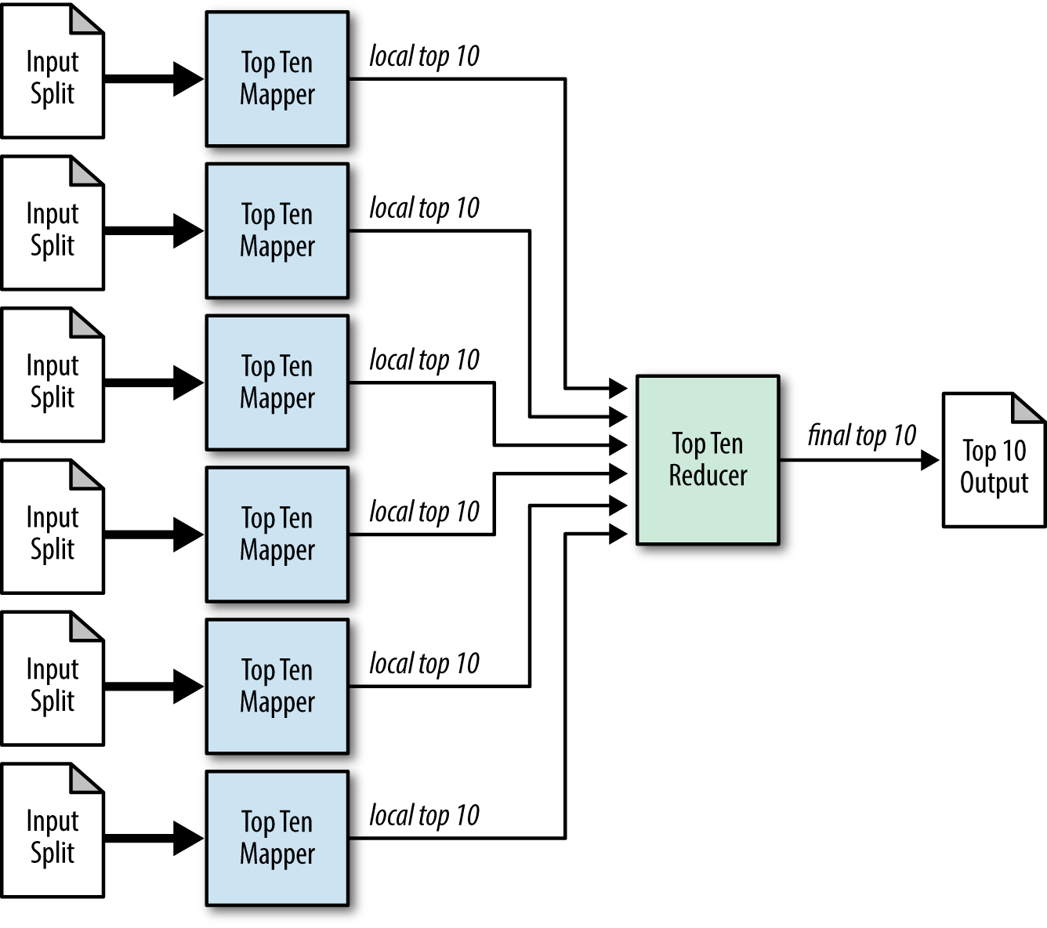
WordCount
Map/Reduce
Job1 Intermediate output is the Input for
Top 10 Map/Reduce Job 2
Top 10 Map/Reduce Job2

Slide 9
Mapper (1 of 2)
public static class Top10Mapper extends Mapper<Object, Text, NullWritable, Text> {
// setup
private TreeMap<Integer, Text> repToRecordMap = new TreeMap<Integer, Text>();
private Text outputValue = new Text();
public void map(Object key, Text value, Context context) throws IOException, InterruptedException {
String[] valueStr = value.toString().split("\t");
String visitorName = valueStr[0];
int visitorCount = Integer.parseInt(valueStr[1]);
outputValue.set(visitorName + "\t" + visitorCount);
// Add this record to our map with the reputation as the key
repToRecordMap.put(visitorCount, outputValue);
// If we have more than ten records, remove the one with the lowest rep
// As this tree map is sorted in descending order, the user with
// the lowest reputation is the last key.
if (repToRecordMap.size() > 10) {
repToRecordMap.remove(repToRecordMap.firstKey());
}
}

Slide 10
Mapper (2 of 2)
@Override
protected void cleanup(Context context) throws IOException,
InterruptedException {
// Output our ten records to the reducers with a null key
for (Text t : repToRecordMap.values()) {
String[] valueStr = t.toString().split("\t");
String visitorName = valueStr[0];
int visitorCount = Integer.parseInt(valueStr[1]);
outputValue.set(visitorName + "\t" + visitorCount);
context.write(NullWritable.get(), outputValue);
}
}
}

Slide 11
Reducer (1 of 2)
public static class Top10Reducer extends Reducer<NullWritable, Text, NullWritable, Text> {
// setup
private TreeMap<Integer, Text> repToRecordMap = new TreeMap<Integer, Text>();
private Text outputValue = new Text();
public void reduce(NullWritable key, Iterable<Text> values,
Context context) throws IOException, InterruptedException {
for (Text value : values) {
String[] valueStr = value.toString().split("\t");
String visitorName = valueStr[0];
int visitorCount = Integer.parseInt(valueStr[1]);
outputValue.set(visitorName + "\t" + visitorCount);
repToRecordMap.put(visitorCount, outputValue);
// If we have more than ten records, remove the one with the lowest rep
// As this tree map is sorted in descending order, the user with
// the lowest reputation is the last key.
if (repToRecordMap.size() > 10) {
repToRecordMap.remove(repToRecordMap.firstKey());
}
}

Slide 12
Reducer (2 of 2)
for (Text t : repToRecordMap.descendingMap().values()) {
// Output our ten records to the file system with a null key
context.write(NullWritable.get(), t);
}
}
}

Slide 13
Thank you

